Slide 1
Introduction to Software Engineering
Understanding Requirements (3)
Muhammad Nasir
m.nasir@iiu.edu.pk

Slide 2
Agenda
Requirement Elicitation
  User Scenario
Specification Principles
Specification Representation
Specification Review

Slide 3
User Scenario
It is difficult to move into more software engineering activities until software team understands how these functions and features will be used by different end-users.
Developers and users create a set of usage threads for the system to be constructed
“A use-case scenario is a story about how someone or something external to the software (known as an actor) interacts with the system”.
Notes:
An Actor models a type of role played by an entity that interacts with the subject (e.g., by exchanging signals and data), but which is external to the subject

Slide 4
User Scenario
Describe how the system will be used
“Each scenario is described from the point-of-view of an “actor”—a person or device that interacts with the software in some way”
It is important to note that an actor and an end user are not necessarily the same thing.

Slide 5
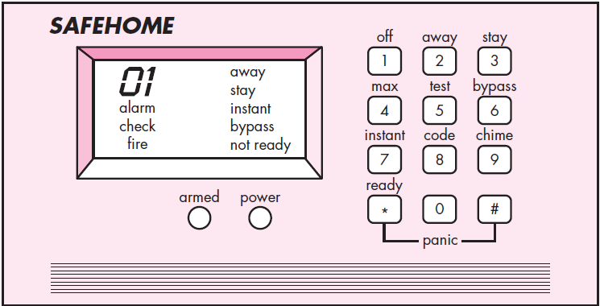
SafeHome – Example

Slide 6
User Scenario
A typical user may play a number of different roles when using a system.
Whereas an actor represents a class of external entities (often, but not always, people)
that play just one role in the context of the use case.

Slide 7
User Scenario
After careful review of requirements, the software for a Automated Control System requires
Four different modes (roles) for interaction: programming mode, test mode, monitoring mode, and troubleshooting mode.

Slide 8
User Scenario
Therefore, four actors can be defined: programmer, tester, monitor, and troubleshooter.
In some cases, the machine operator can play all of these roles.
In others, different people may play the role of each actor.

Slide 9
SafeHome – Usage Scenarios
For the purposes of this example we consider only the homeowner actor.
Home Owner may interact with system in following way
  Enters a password to allow all other interactions.
  Inquires about the status of a security zone.
  Inquires about the status of a sensor.
  Presses the panic button in an emergency.
  Activates/deactivates the security system.

Slide 10
SafeHome – Basic Use Cases
1. The home-owner observes the SafeHome control panel to determine if the system is ready for input.
  If the system is not ready, a not ready message is displayed on the LCD display, and the home-owner must physically close windows or doors
  So that the not ready message disappears.
    [A not ready message implies that a sensor is open; i.e., that a door or window is open.]

Slide 11
SafeHome – Basic Use Cases
2. The homeowner uses the keypad to input a four-digit password.
  The password is compared with the valid password stored in the system.
  If the password is incorrect, the control panel will beep once and reset itself for additional input.
  If the password is correct, the control panel awaits further action.

Slide 12
SafeHome – Basic Use Cases
The homeowner selects and input stay or away to activate the system.
  Stay activates only perimeter sensors (inside motion detecting sensors are deactivated).
  Away activates all sensors

Slide 13
SafeHome – Basic Use Cases
When activation occurs,
  A red alarm light can be observed by the homeowner.

Slide 14
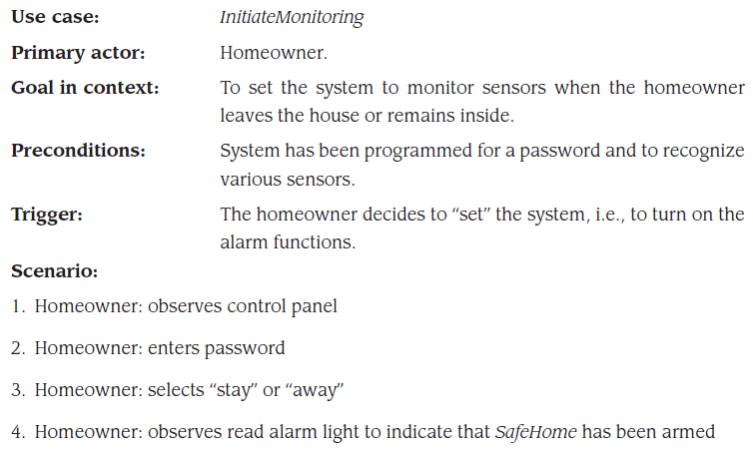
SafeHome – Detail Use Case

Slide 15
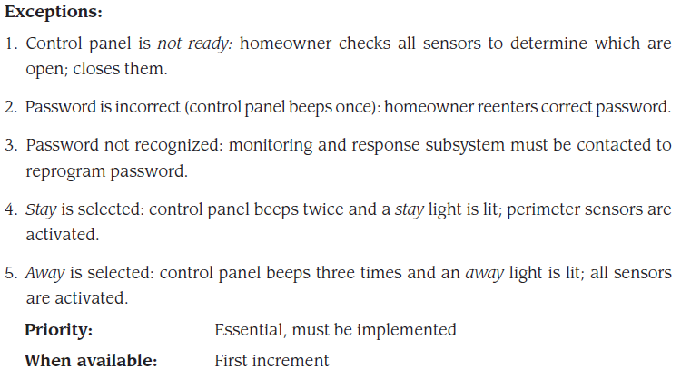
SafeHome – Detail Use Case

Slide 16
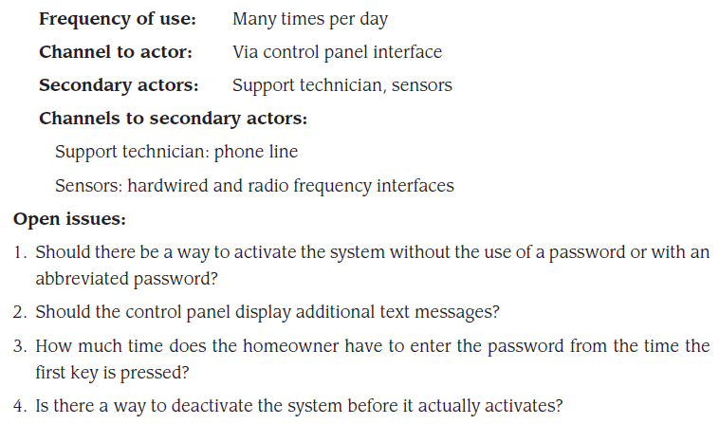
SafeHome – Detail Use Case

Slide 17
Specification Principles
If specification incomplete, inconsistent, or misleading specifications result in confusion.
Separate functionality from implementation.
Develop a model of the desired behavior of a system.
Establish the context in which software operates by specifying the manner.
Define the environment in which the system operates and indicate how.

Slide 18
Specification Principles (cont.)
Create a cognitive model rather than a design or implementation model.
The specifications must be tolerant of incompleteness.
Establish the content and structure of a specification in a way that it could be easy to change.
Notes:
Augment: To increase or make greater, as in value, beauty, or reputation
Amenable : Responsive to advice, authority, or suggestion

Slide 19
Specification Representation
Representation format and content should be relevant to the problem.
  For example, a specification for a manufacturing automation system might use different diagrams and language than the specification for a programming language compiler.
Information contained within the specification should be nested (layered).
  Paragraph and diagram numbering schemes should indicate the level of detail that is being presented.
  It is sometimes worthwhile to present the same information at different levels of abstraction to aid in understanding.

Slide 20
Specification Representation
Diagrams and other notational forms should be restricted in number and consistent in use.
  Confusing or inconsistent notation, whether graphical or symbolic, degrades understanding and fosters errors.
Representations should be revisable.
  It contains a complete information description, a detailed functional description, a representation of system behavior, an indication of performance requirements and design constraints, appropriate validation criteria, and other information pertinent to requirements.

Slide 21
Software Requirements Specification
Format of SRS:
Introduction of the software requirements specification states the goals and objectives of the software, describing it in the context of the computer-based system.
Information content, flow, and structure are documented. Hardware, software, and human interfaces are described for external system elements and internal software functions.
Functional Description A processing narrative is provided for each function, design constraints are stated and justified & performance characteristics are stated
Behavioral Description operation of the software as a consequence of external events and internally generated control characteristics.

Slide 22
Software Requirements Specification (Cont.)
Validation Criteria is probably the most important and, ironically, the most often neglected section of the Software Requirements Specification (SRS). Testing or validating each user-scenario.
Finally, the specification includes a Bibliography and Appendix. The bibliography contains references to all documents that relate to the software. The appendix contains information that supplements the specifications

Slide 23
Specification Review
A review of the SRS (and/or prototype) is conducted by both the software development team and the customer.
Conducted at a macroscopic level
    Ensure that specification is complete
    Consistent
    Accurate (Information, functional and behavioral domain considered).
Review becomes more detailed while examining Information, functional and behavioral domain.
Examining not only broad descriptions but the way in which requirement worded.
E.g. Terms like “Vague ” (some, sometimes, often, usually) should be flag by reviewer for further clarification.

Slide 24
Review (cont.)
Once review is complete – SRS “signed off” by both customer and vendor. ( “contract” for software development)
Requests for changes in requirements after the specification is finalized will not be eliminated.
Change is an extension of software scope and therefore can increase cost and/or delivery time of product.
During the review, changes to the specification may be recommended.
It can be extremely difficult to assess the global impact of a change; that is, how a change in one function affects requirements for other functions

Slide 25
The End
Thanks for listening
Questions would be appreciated.

